Slide 1


R Programming

Slide 2
What is R ?
A programming “environment” developed by Rick Becker
Similar to S & S-Plus developed by John chambers
Object-oriented
Has large integrated collection of tools for statistical data analysis and machine learning
Provides easy calculations on matrices
Excellent graphics capabilities

Slide 3
Why R?
It is powerful
It is free
Extensive support documentation
It is current (New algorithms)
It is getting easier to learn
It is independent of the platform

Slide 4
Things to be noted in R
It is a case-sensitive, interpreted language
You can enter commands one at a time at the command prompt (>)
You can run a set of commands from a source file
Most functionality is provided through built-in and user-created functions
All data objects are kept in memory during an interactive session

Slide 5
Things to be noted in R
Basic functions are available by default
Other functions are contained in packages that can be attached to a current session as needed.

Slide 6
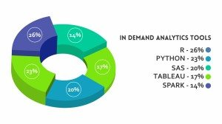
Is it worth studying R
Src: https://imarticus.org/data-analytics-market-growth-and-scope-analysis-in-2018/

Slide 7
What is RStudio?
R Studio is an IDE
Allows to run R in a user-friendly environment
Open Source
Available at http://rstudio.com/

Slide 8
Why R Studio?
Code highlighting that gives different colors to keywords and variables, making it easier to read
Automatic bracket matching
Code completion, so as to reduce the effort of typing the commands in full
Easy access to R Help, with additional features for exploring functions and parameters of functions
Easy exploration of variables and values.

Slide 9
Where to get the software?
Web Resources
R - https://cran.r-project.org/
Rstudio – https://www.rstudio.com

Slide 10
Installation
Web Resources
R - https://cran.r-project.org/
Rstudio – https://www.rstudio.com

Slide 11
Installation in Windows

Slide 12
Installing R
www.cran.r-project.org/ - direct download
www.r-project.org/ - download from CRAN (Comprehensive R Archive Network)
Select a download site
There are 25 packages that are supplied with R
However, many packages are available in CRAN website which can be downloaded as needed

Slide 13
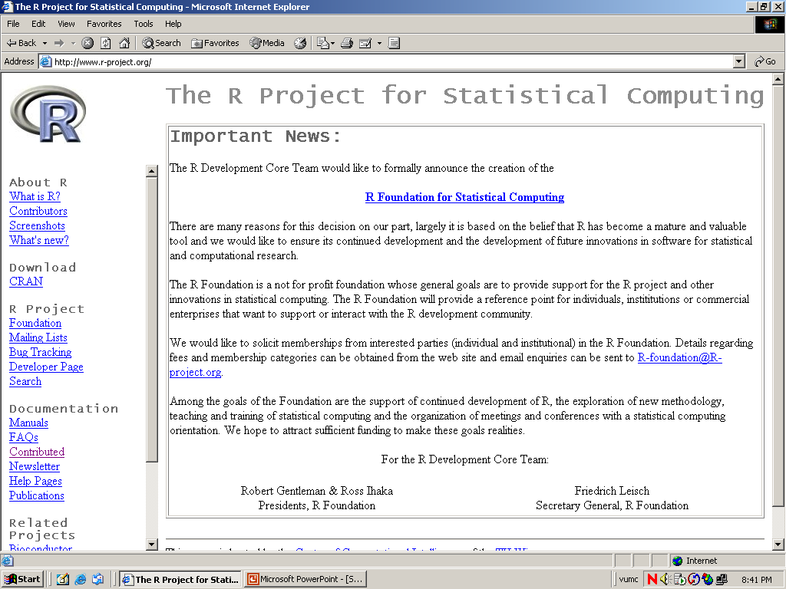

Slide 14
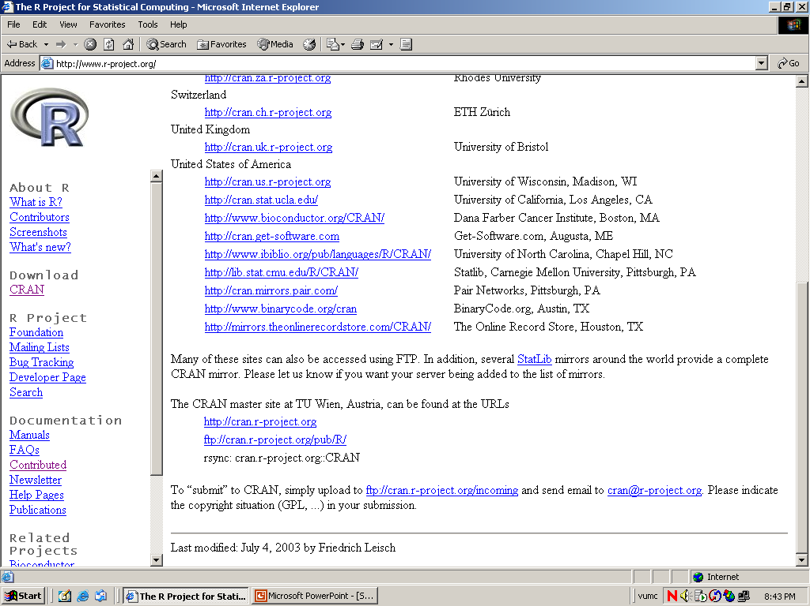

Slide 15
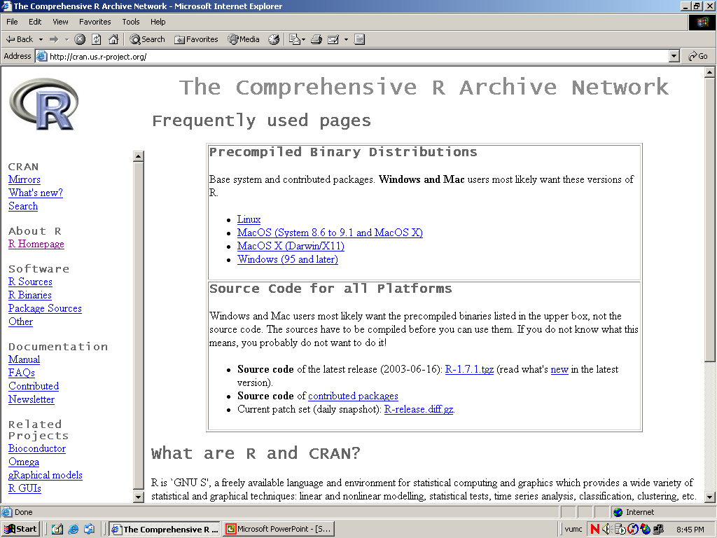

Slide 16
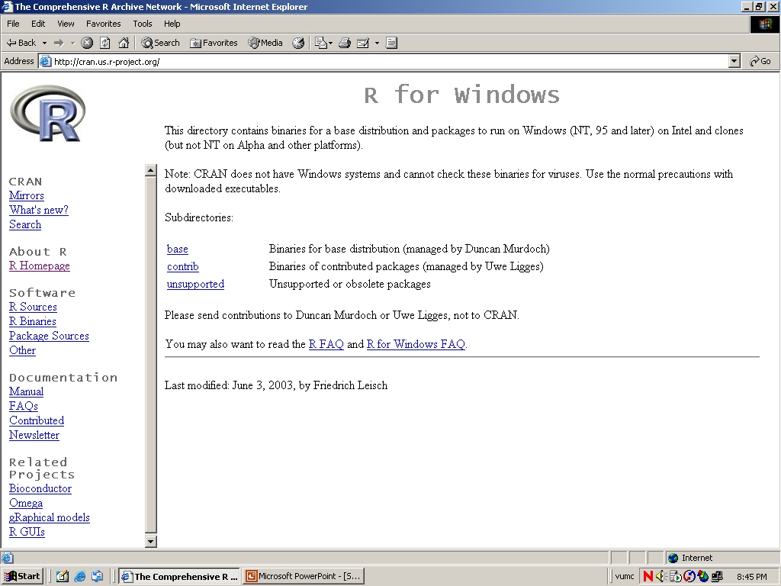

Slide 17
Installation in Ubuntu

Slide 18
Ubuntu
Through Terminal
Open Terminal (Press Ctrl+Alt+T)
Then execute sudo apt-get update
After that, sudo apt-get install r-base
To run R statistical package, execute R in the Terminal

Slide 19
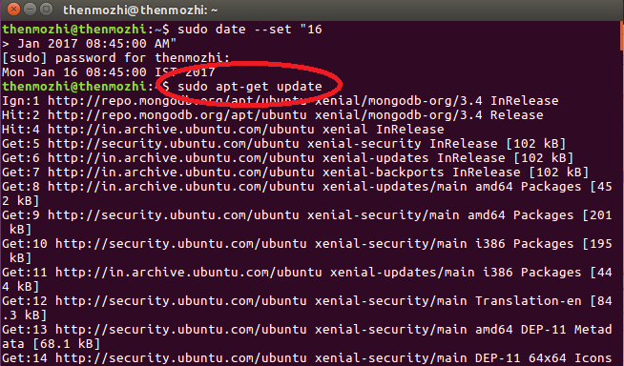

Slide 20
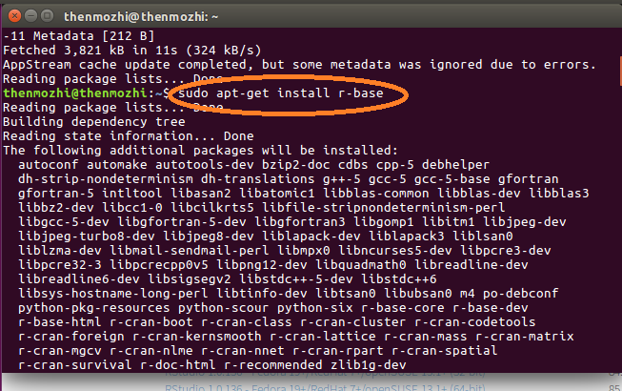

Slide 21
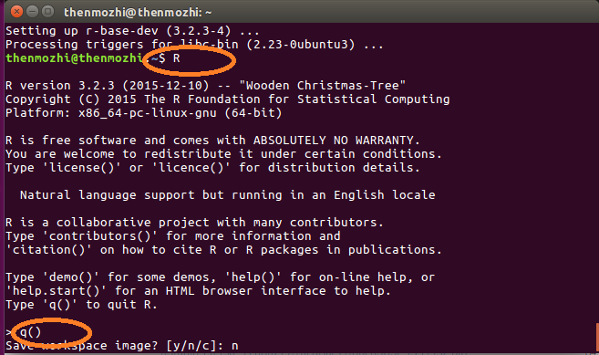

Slide 22
Through Ubuntu Software Center
Open Ubuntu Software Center
Search for r-base
And click Install
Run R by executing R in the Terminal

Slide 23
Installation of RStudio

Slide 24
To Install R Studio
To install RStudio IDE, do the following:
Go to rstudio.com web page
Click Download RStudio Desktop
Click for the download link recommended for your system
Run the downloaded file (double click the file) to start the setup wizard
Click “Next” until “Finish”

Slide 25
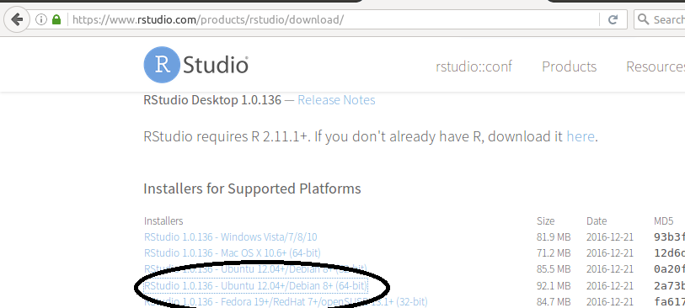

Slide 26
Tutorials
From R website under “Documentation”
“Manual” is the listing of official R documentation
An Introduction to R
R Language Definition
Writing R Extensions
R Data Import/Export
R Installation and Administration
The R Reference Index

Slide 27
Exploring RStudio
Script / Workspace Window
Environment Window
Console window
Explore Window/Support Window/service window

Slide 28
Working Directory
Create working directory for convenience
Menu -> Session->set working directory->choose directory

Slide 29
Installing/Listing Packages
To install packages
install.packages("labstats")
To list all the packages enabled or used in the session
(.packages())
To list all the packages available with the system
(.packages(all.available=TRUE))

Slide 30
To know keyboard shortcuts
https://support.rstudio.com/hc/en-us/articles/200711853-Keyboard-Shortcuts

Slide 31
R Basics

Slide 32
Arithmetic with R
Calculator
Write any expression in the command prompt
Any expression or statement not to be interpreted --- Comment ( # )

Slide 33
Arithmetic with R- Contd..
Arithmetic with R
Addition: +
Subtraction: -
Multiplication: *
Division: /
Exponentiation: ^
Modulo: %%

Slide 34
Variable Assignment
A variable allows you to store a value (e.g. 4) or an object (e.g. a function description) in R
Access values with the name of the variable at later point of time.
my_var <- 4 or
my_var=4 [acceptable format version >1.4]
To print the value of the variable
print(my_var)

Slide 35
Naming Convention
Must start with a letter (A-Z or a-z)
Can contain letters, digits (0-9), and/or periods “.”
Is case-sensitive
mydata different from MyData

Slide 36

Create variable my_oranges and store 6
Create variable my_apples and store 5
Create my_fruits which has total fruits of my_oranges and my_apples
Print my_fruits

Slide 37
Basic Modes of Data
Numeric – Decimal Values (Eg. 4.5)
Logical – Boolean Values ( Eg: TRUE)
Characters – Text values (Eg: Rama)

Slide 38
Functions for Managing Modes
To check the type of the variable
class()
To check whether it belongs to data type
is.numeric(), is.character()
To type coerce the data
as.numeric(), as.character()
Do it meaningfully

Slide 39
Extended modes of Data
Integers – Natural numbers ( Eg: 4)
Date – Date format (Eg:2007/03/09”)

Slide 40
Create my_n=42.4, my_c=“Universal” & my_l=FALSE
Print the values
Find the class of each variable
Change the my_n as integer
How to check whether my_l is a boolean variable?
Type my_cc=universe. What is the output?
Type my_ll=false,. What is the output?
Type my_ll=F. what is the output?
Print my_ll. Check the class of my_ll.

Slide 41
Type my_ll at the prompt. What you get? What is your observation?
Do my_n=my_n+5
Do my_c=my_c+5
Do my_c=my_c + ”truth”. What is the output?
Do paste(my_c,”truth”). What is the output?

Slide 42
R Objects
Vector – homogeneous values (1D)
Matrix – homogeneous values (2D)
List – heterogeneous (1D)
Data frame – heterogeneous (2D)
Factor – Categorical values (1D)

Slide 43
Vector
A vector is a sequence of data elements of the same basic type.
Vector Elements are called components.

Slide 44
Numeric Vector
A numeric vector contains all numeric components.
c() is function that is used to create vectors. It is called as combine/concatenate function
Vector can hold any number of elements

Slide 45
Creation of numeric vectors
> x =c(0,1,2,3,4) # creation of vectors
> x # display of vectors
> print(x) # display of vectors
Easy way of creating sequence numbers
> y = 1:50 #sequence of numbers
> y
>z=seq(1,50,by=2) #seq of odd numbers

Slide 46
Creating vectors with variables
> a=10
> b=15
> c=c(a,b)
Creating Vectors with repeated elements
> a=rep(1,10) #1st - element,2nd no of times

Slide 47
Creating named vectors
> my_fruits=c(apple=1,guava=1,
strawberry=10)
> my_fruits

Slide 48
Character Vectors
> fruits <- c("apple","orange","banana")
> fruits
Easy way of creating Sequence of Letters
> alphabets=LETTERS[1:26]

Slide 49
Logical Vectors
Vectors created using logical values
> a=c(T,F,F,T,T,T,F)
> b=c(1,1,0,0,0) #0- False, 1-True
> b=as.logical(b)

Slide 50
Type Coercion of Vectors
> a=10
> b=TRUE
> My_v<-c(a,b)
> class(My_v) # it is numeric
> My_c
10 1
> test<- c(1,2,"red","orange")
> test
"1" "2" "red" "orange"

Slide 51
Checking the Vector
To check whether it is vector?
> is.vector(test)
[1] TRUE
To Check the mode of the vector
> is.character(test)
[1] TRUE

Slide 52
Conversion of vectors
> test = as.integer(c(1,2,3.14,1.29))
> test
[1] 1 2 3 1

Slide 53
Associating names for the vector
>a=c(10,20,30,40,50)
>b=c("Eng","Kann","Mat","Sci","Social")
>names(a)=b > a
Eng Kann Mat Sci Social
10 20 30 40 50

Slide 54
Subscripting Vectors
select only one element
x[2]
select range of elements
x[1:3]
select all but one element
x[-3]

Slide 55
Subscripting Vectors
slicing: including only part of the object
x[c(1,2,5)]
select elements based on logical operator
x[x>3]

Slide 56
Adding Elements to the vector
> a=1:10
> a=c(a,11:15)

Slide 57
Vector Arithmetic
> x <- c(0,1,2,3,4)
> y <- 1:5
> z <- 1:50
> x + y
[1] 1 3 5 7 9
> x * y
[1] 0 2 6 12 20
> x * z (cycling)
[1] 0 2 6 12 20 0 7 16 27 40 0
[12] 12 26 42 60 0 17 36 57 80 0 22
[23] 46 72 100 0 27 56 87 120 0 32 66
[34] 102 140 0 37 76 117 160 0 42 86 132
[45] 180 0 47 96 147 200

Slide 58
Arithmetic operators
Operator Description
+ addition
- subtraction
* multiplication
/ division
^ or ** exponentiation
x %% y modulus (x mod y) 5%%2 is 1
x %/% y integer division 5%/%2 is 2

Slide 59
Logical & Relational operators
Operator Description
< less than
<= less than or equal to
> greater than
>= greater than or equal to
== exactly equal to
!= not equal to
!x Not x

Slide 60
Logical and Relational operators
Operator Description
x | y element wise OR
x & y Element wise AND
isTRUE(x) test if X is TRUE
x&&y Object wise AND
X||y Object wise OR

Slide 61
Basic operations
> x=c(1:10)
> (x>=10)|(x<10)
[1] TRUE TRUE TRUE TRUE TRUE TRUE TRUE TRUE TRUE TRUE
> (x>=10)&(x<10)
[1] FALSE FALSE FALSE FALSE FALSE FALSE FALSE FALSE FALSE FALSE
> (x>=10)&& (x<10)
[1] FALSE
>(x>=10)|| (x<10)
[1] TRUE

Slide 62
Few Understanding
What happens if any element is of different data type?
Type coercion happens
What happens if arithmetic operations done on a variable length vectors?
Cycling
Is it possible to create an empty vector?
Yes a=c()

Slide 63
Few Understanding – Contd..
How to check whether it is a vector?
is.vector()
Can we repeat same element in a vector multiple times?
rep(number,no of times)
rep(0,3)

Slide 64
Factor
Categorical values stored in Levels
They can store both strings and integers.
They are useful in the columns which have a limited number of unique values.
Eg: Gender:"Male, "Female“
Grades:S,A,B,C,D,E
Rating:1,2,3,4,5

Slide 65
Creation of Factors
Factor has to be created as form of vectors
a=factor(c("1","2","5","5"))
It is created as a vector and then it has to be converted as factor using as.factor(vector)
data <- c("East","West","East","North","North","East","West", "West","West","East","North")
factor_data <- as.factor(data)

Slide 66
Matrix
A matrix is a vector with an additional attribute (dim) that defines the number of columns and rows
Can be created using matrix()
x<-matrix(data=0,nrow=2,ncol=2) or
x<-matrix(0,2,2)

Slide 67
mat1=matrix(1:6,nrow=3)
mat1=matrix(1:6, nrow=2, byrow=FALSE)
Identical matrix
mat2=diag(3) # all diagonal element is 1
Edit a matrix
fix(mat2)

Slide 68
Matrix Subscripting
Accessing elements row wise/column wise
All rows of column1 - mat[,1]
All columns of row2 – mat[2,]
Element of row1 col2 – mat[1,2]
All columns expect col3 – mat[,-3]
All rows expect row2 – mat[-2,]

Slide 69
rbind(),cbind()
Add a new row to the existing matrix
rbind(mat2,7:9)
Add a new column to the existing matrix
cbind(mat2,c(10,15,12))
Naming of column and row names
colnames(mat2)=c(“col1”,”col2”,”col3”)

Slide 70
List
Ordered collections of objects
Each component can be of variable length
Creation of List
a=list(“Teachers”,3,c(“Radha”,”Krishna”,”Bama”))

Slide 71
List – Contd..
Accessing a list
double bracket [[ ]] is used to select components of the list
single bracket [ ] is used to select elements of the I component
Eg: a[[3]][2:3] – retrieves krishna, bama
A[[3]] – retrieves all elements of the 3rd component

Slide 72
Data Frame
Fundamental data structure to store to start typical datasets
Can contain heterogenous data
All rows should be of equal length
Column should have same data type
Several modes allowed within a single data frame

Slide 73
Data Frame – Contd..
Can be created using data.frame()
L<-LETTERS[1:4] #A B C D
x<-1:4 #1 2 3 4
a=data.frame(x,L) #create data frame

Slide 74
Ex: Creating Employee data frame
> emp.data <- data.frame(
emp_id = c (1:5),
emp_name= c("Ricky","Danish","Mini","Ryan","Gary"),
salary = c(643.3,515.2,671.0,729.0,943.25),
start_date = as.Date(c("2012-01-01", "2013-09-23", "2014-11-15", "2014-05-11","2015-03-27")))

Slide 75
Data Frame – Contd..
Accessing - $
Eg:a$x
Testing
is.data.frame()
Coercing
as.data.frame()

Slide 76
Data Frame – Contd..
Structure of data frame
str()
To find number of rows
nrows()
To find the dimension
dim()

Slide 77
Subscripting DataFrame
Creating a data frame from another dataframe
result=data.frame(emp.data$emp_name,emp.data$salary)
Extracting first two rows
emp.data[1:2,]
Extracting first and third rows
emp.data[c(1,3),]

Slide 78
Subscripting DataFrame
Extract 3rd and 5th row with 2nd and 4th column emp.data[c(3,5),c(2,4)]

Slide 79
Operations
Adding a new column
>emp.data$dept= c("IT","Operations","IT","HR","Finance")
Adding a new row
> newrow=data.frame(emp_id=6, emp_name=“Raksha”, salary=900,start_date=“2018-09-22”,dept=“Finance”)
> emp.data=rbind(emp.data,newrow)

Slide 80
Find those who work in finance dept
emp.data[emp.data$dept==“Finance”,]
Find those who work in finance dept and salary > 925
emp.data[emp.data$dept=="Finance"&emp.data$salary>925,]

Slide 81
Create a vector weekdays which has seven days of the week
Create a vector temp which has temp on seven days of the week
Create a vector sale which has the data of sale of icecreams on seven days of the week
Create a dataframe named soi which comprises weekdays, temp and sale
Change the weekdays as factor
Check the data frame components types
Print the temp column from soi

Slide 82
Print the weekdays and sale from soi
Print when the sale is more than 10
Print the records where temp is more than 32 and sale of icecream is more than 15

Slide 83
Reading resources
https://www.listendata.com/p/r-programming-tutorials.html

